Slide 1
Tips for Taking the PSAT
Harrison High School
Test Date: October 13, 2021

Slide 2
General Testing Information
October 13, 2021
All students will report to assigned testing location upon arrival at school
Testing begins promptly at 8:20 am
Bring 2 or more No. 2 pencils (sharpened with erasers) and an approved calculator

Slide 3
Test Sections and Times
The Reading Test – 60 minutes, 47 questions.
The Writing and Language Test – 35 minutes, 44 questions.
Math Test, No Calculator Portion – 25 minutes, 17 questions.
Math Test, Calculator Portion – 45 minutes, 31 questions.

Slide 4
Section One: Reading
The Reading Test always includes:
One passage from a classic or contemporary work of U.S. or world literature.
One passage or a pair of passages from either a U.S. founding document or a text in the Great Global Conversation they inspired. The U.S. Constitution or a speech by Nelson Mandela may be used, for example.
A selection about economics, psychology, sociology, or some other social science.
Two science passages (or one passage and one passage pair) that examine foundational concepts and developments in Earth science, biology, chemistry, or physics.

Slide 5
Section One: Reading
Question Types | Academic Vocabulary & Skills
Words in Context Command of Evidence Analysis in History/Social Studies Analysis in Science | Evidence Context clues Author's style Tone Hypothesis Implications Shifts Connotation Purpose Inference Structure

Slide 6
Section Two: Writing and Language
When you take the Writing and Language Test, you’ll do three things that people do all the time when they write and edit: read, find mistakes and weaknesses, and fix them.
All questions are multiple choice and based on passages.
Some passages are accompanied by informational graphics, such as tables, graphs, and charts—but no math is required.
Prior topic knowledge is never tested.

Slide 7
Section Two: Writing & Language
Question Types | Academic Vocabulary & Skills
Standard English Conventions Expression of Ideas Command of Evidence | Parallel Structure Pronoun/Antecedent Agreement Subject/Verb Agreement Parenthetical Clause Sentence Fragment Misplaced, Ambiguous, & Dangling Modifiers Structure: Introduction & Conclusion Details vs. General Information Evidence/Support Comma, Colon, & Semicolon

Slide 8
Sections Three & Four : Math
Question Types | Skills Assessed
Problem Solving and Data Analysis Heart of Algebra Passport to Advanced Math | Linear expressions Linear inequalities Linear functions Algebraic and graphical representations Ratios, rates, proportional relationships, scale drawings Multi-step problems Percentages Scatterplot, linear, quadratic, or exponential models Shape, center, spread Add, subtract, and multiply polynomial expressions Radicals Variable in the denominator of a fraction

Slide 9
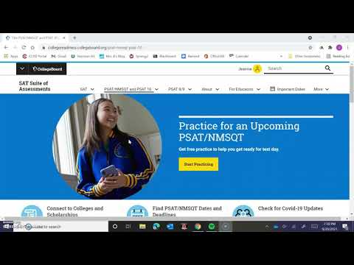
Sections Three & Four : Math

Slide 10
Practicing PSAT Questions
Go to freerice.com to practice your vocabulary skills and support the World Food Program.
Review your missed questions on last year's PSAT on your College Board profile.
Link your College Board account to Khan Academy and engage in individualized PSAT practice.
Visit the Writing Center before and/or after school to practice on Khan Academy and College Board.
Review your "Tips for Taking the PSAT" handout.

